Slide 1
Rounding / Estimation
Miss L
Year 11 Essentials

Slide 2
Learning Intentions
Students will be able to
Round decimals
Estimate objects

Slide 3
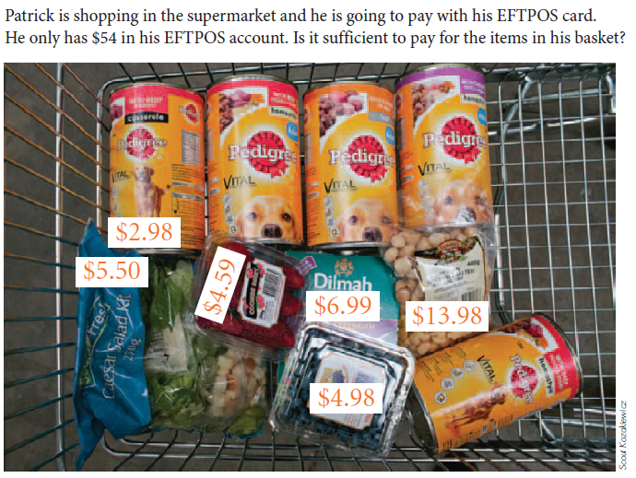

Slide 4

Think - Pair - Share
What was the quickest way to calculate the total of the shopping trolley?
Why is it a good idea to know how to estimate numbers?

Slide 5
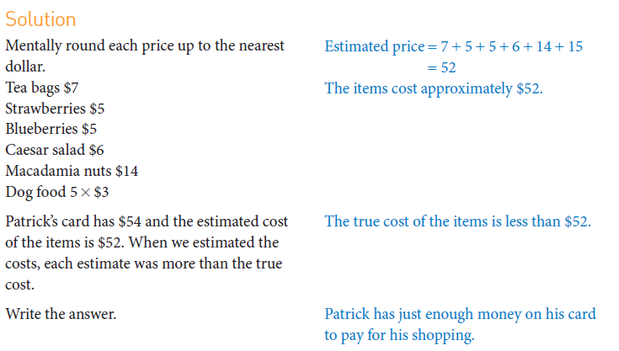

Slide 6
24
7
30
Number Review
Date
EQ – Why do we need to round decimal numbers?
2.365 038 475 can just as easily be written as 2.4
We can round off decimal numbers that have more figures in them than required.
If the digit after the one being rounded off is less than 5 we round down
If the digit after the one being rounded off is 5 or more we round up
Rules for rounding numbers?

Slide 7


Slide 8
Lighting Round
Numbers will flash up on the screen
You will need to round to the nearest whole number
Person that has the most correct wins

Slide 9
Ready?
4.6
7.4
33.6
87.5
287.6
65.3
49.6
399.8
Fin

Slide 10
Answers
5
7
34
88
65
288
50
400

Slide 11
24
7
30
Number Review
Date
EQ – Why do we need to round decimal numbers?
How do we round to a certain number?
Example: 2185
2190 (to the nearest 10)
2200 (to the nearest 100)
2000 (to the nearest 1000)
Example: 2.1852
2.185 (to 3 decimal places (d.p))
2.19 (to 2 d.p)
2.2 (to 1 d.p)
2 (to the nearest whole number)

Slide 12
Estimation Bingo
Aim: Full House
Grid: 9 Grid
Play: Calculate answer & cross it off

Slide 13
Use any of these numbers in your grid (NO REPEATS except 70)
15.4
0.299
70
0.5
70
124.4
6.9
3.453
67
3.66
900
29
31
200
15.01
11.36

Slide 14
Round 1

Slide 15
Round 2

Slide 16

Round 3

Slide 17

Round 4

Slide 18
Round 5

Slide 19
Round 6

Slide 20
Round 7

Slide 21
Round 8

Slide 22

Round 9

Slide 23

Round 10

Slide 24
Round 11

Slide 25

Round 12

Slide 26

Round 13

Slide 27
Round 14

Slide 28

Round 15

Slide 29

Round 16

Slide 30
Task
Rounding and Estimation Worksheet from Nelson Chpt 1 Part A

